Slide 1

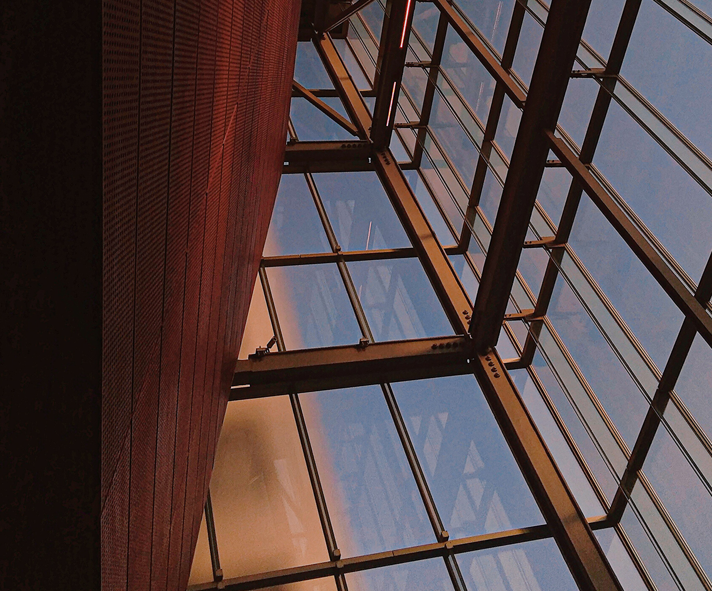

PAID
ADVERTISEMENT
Grotal

Slide 2

Advertise
On Grotal
We will show your business at No. 1 position
on the internet by beating your competitors and help you to boost your sales
Grotal.com | 2022

Slide 3
Keyword Based Advertisement
BUSINESS NAME
DEALING IN
ABC Enterprises
Washing Machine, AC Repair, Refrigerator, LED TV, Second Hand AC
EXAMPLE:
Businessman ABC Enterprises wants his business information to be seen on top of all on Grotal for Delhi city whenever any user is looking for AC Repair, LED TV and Second Hand AC on Grotal for next 3 months.
Grotal.com | 2022

Slide 4
Advertisement Process
He chooses 3 keywords for 3 months for 1 Location
3 (keywords) * 10 (Rs. per Keyword) * 90 Days (3 months)*1(City) = Rs.2,700 + 18% (GST)
Now his business will be shown on 1st position of all in the list of AC Repair, LED TV and Second Hand AC on Grotal.com for 3 months (If anyone paid Rs.11, then his business will be shown on 2nd position)
(whenever anyone searches any thing on Grotal, a list of businesses are shown up, the list is random, no one’s business is shown on top position permanently except those who pay for it)
Grotal.com | 2022

Slide 5
How To Advertise?
STEP 1
STEP 2
STEP 3
STEP 4
STEP 5
STEP 6
STEP 7
Login
Dashboard
Click on
blinking text
Choose keywords & Duration
Pay
Grotal.com
Done
Grotal.com | 2022

Slide 6
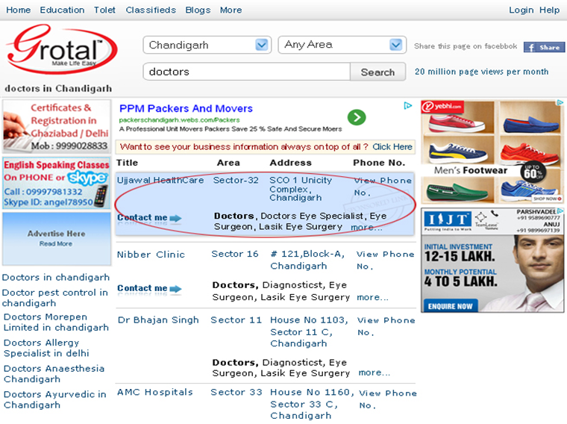
KEYWORD BASED ADVERTISEMENT LOOKS LIKE AS GIVEN BELOW SCREENSHOT
Grotal.com | 2022

Slide 7
Banner Based Advertisement
Group Based
Banner Location : Left side of Grotal search result page
Banner Size : 172×90
Keyword : Banner is not keyword based, it is city based
Cities : You can show your banner in multiple cities
Price : Depends on the Group of cities you choose
Grotal.com | 2022

Slide 8
EXAMPLE
Ravi Malhotra wants his banner to be shown in Delhi, Mumbai, Pune, Agra, Baddi for 60 days
  Delhi falls in Group 1 and costs 200 Rs a day
  Mumbai falls in Group 2 and costs 100 Rs a day
  Pune falls in Group 3 and costs 50 Rs a day
  Agra and Baddi falls in Group 4 and each costs 15 Rs a day
Total Costs : (200 (Delhi) × 60 (days) ) + (100 (Mumbai) × 60 (days) ) + (50 (Pune) × 60 (days) ) +(15*2 (Agra and Baddi) × 60 (days) ) = Rs.22,800 + 18% (GST)
Grotal.com | 2022

Slide 9

BANNER BASED ADVERTISEMENT LOOKS LIKE AS GIVEN BELOW SCREENSHOT
Grotal.com | 2022

Slide 10

PAYMENT MODE
DEBIT CARD, CREDIT CARD, NET BANK
OR
BANK TRANSFER (CASH/CHEQUE) ON ACCOUNT
BANK NAME : ICICI BANK LIMITED
ACC. HOLDER : GROTAL INFOTECH PRIVATE LIMITED
ACC. NO : 001305011231
IFSC CODE : ICIC0000013
ADDRESS : SECTOR 9, CHANDIGARH, INDIA
Once deposited in any ICICI branch in your area, please call on 099 14 77 88 99
Grotal.com | 2022

Slide 11
GET IN TOUCH
MAIN BRANCH ADDRESS
C136, Phase 8, Industrial Area, Sector 62, Sahibzada Ajit Singh Nagar, Punjab 160071
PHONE/WHATSAPP
99147 78899
EMAIL
info@grotal.com
WEBSITE
www.grotal.com

